Slide 1

Credit Card Fraud Identification Using ML
Final Project – Group 1: Stan Taov, Manoj Soman Nair, Luiz Augusto de Carvalho
Instructor: Hashmat Rohian

Slide 2
The Context
The current process can stop 50% of all fraudulent transactions (4%) and has a false positive rate of 2%.
Frauds correspond to just 4% of all transactions but they answer for 8% of the total value.
Each 1% of fraud elimination corresponds to approximately R$ 16.000.000,00 /month (CAD 5.330.000,00).

Slide 3
Business Problem/Objective
The mechanisms in place that detects potential fraudulent transactions, have two problems:
Deploy semi-static rules what demand effort to adjust
Its is hard to have a middle term between being too stringent (blocking legit sales) or being too lose (high volume of fraud).
The objective is to create a model that would not only identify a high proportion of the frauds adapting automatically to changes in the patterns but also do that with a low false positive rate.

Slide 4
Data
We used a real anonymized and sanitized dataset representing a subset of the transactions that occurred during one day of September of 2019 in Brazil, totalling 290.398 transactions.

Slide 5
Data Dictionary
Information regarding the clients:
Age
Sex
Income
Average expenditure in recurrent payments per transaction
Average expenditure buying goods (Using the card directly) per transaction
Average expenditure buying services (using the card directly) per transaction
Average expenditure buying goods on-line per transaction
Average expenditure buying services on-line per transaction
Information about the seller:
Score of the seller (Number 0 to 100) indicating the ranking of the seller regards frequency of frauds.
Information about the transactions:
Type: which one of the five categories it belongs (0-recurrent, 1- goods, 2-services, 3-online goods or 4-online services).
Value of the transaction
If the addresses of the seller and the buyer are in the same city
If the addresses of the seller and the buyer are in the same country
If the transaction was fraudulent or not (Y or N)

Slide 6
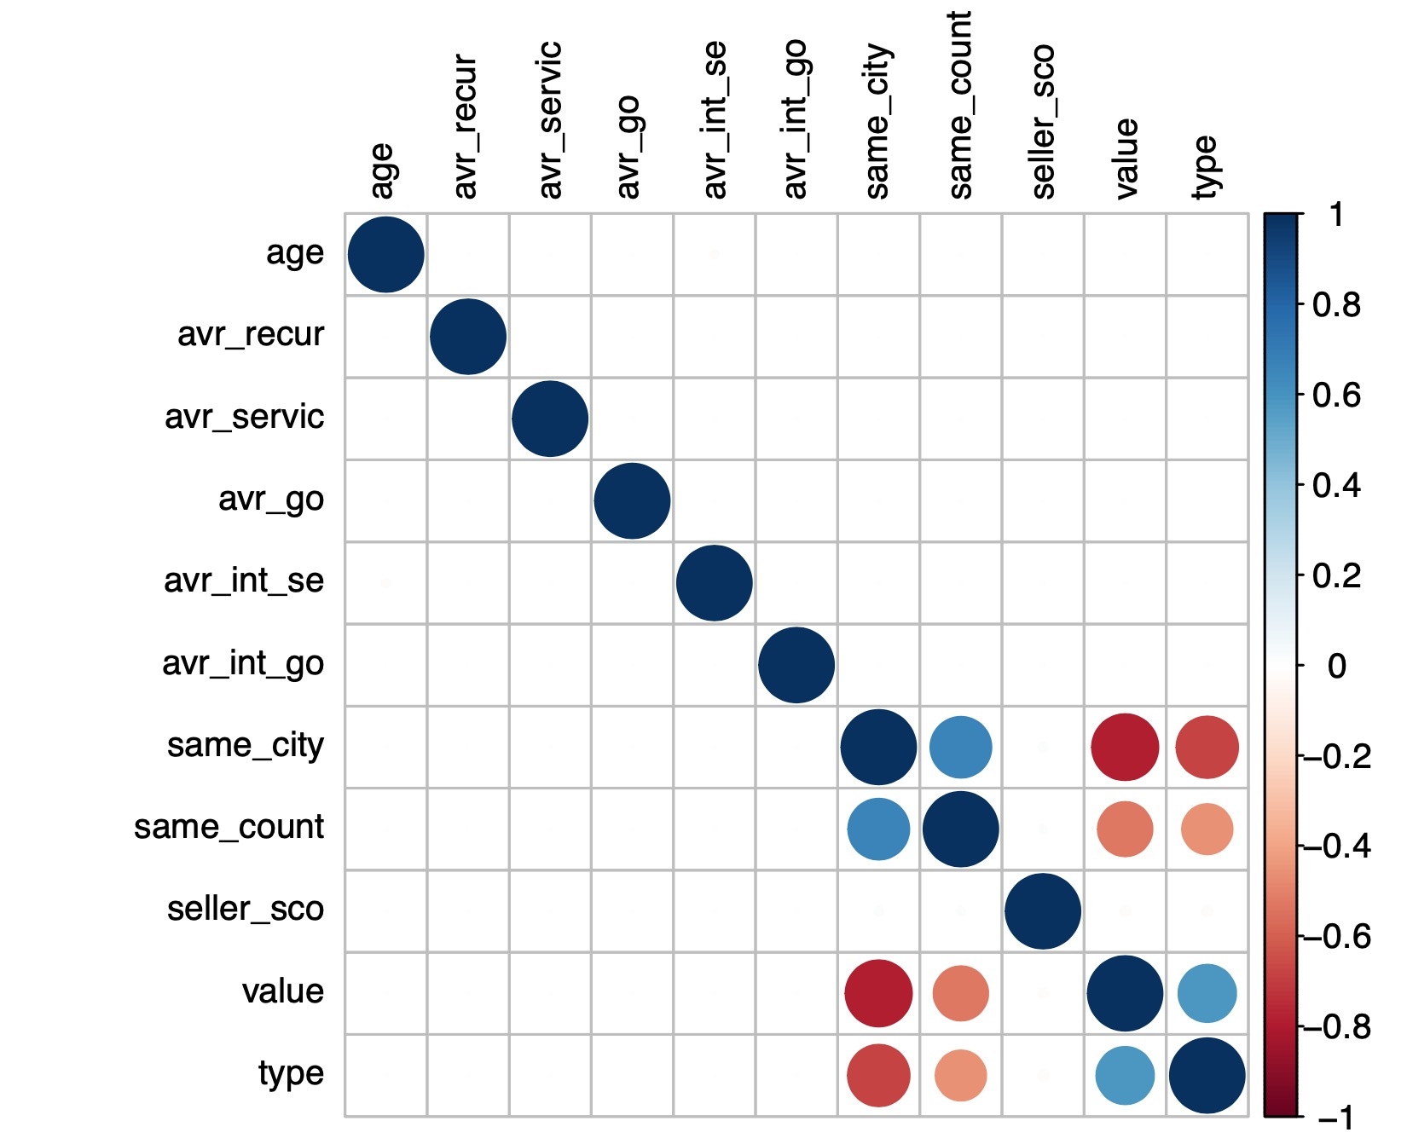
Data Exploration
Correlations between features
We can observe that most of the features in our dataset are not correlated or have weak correlations.

Slide 7
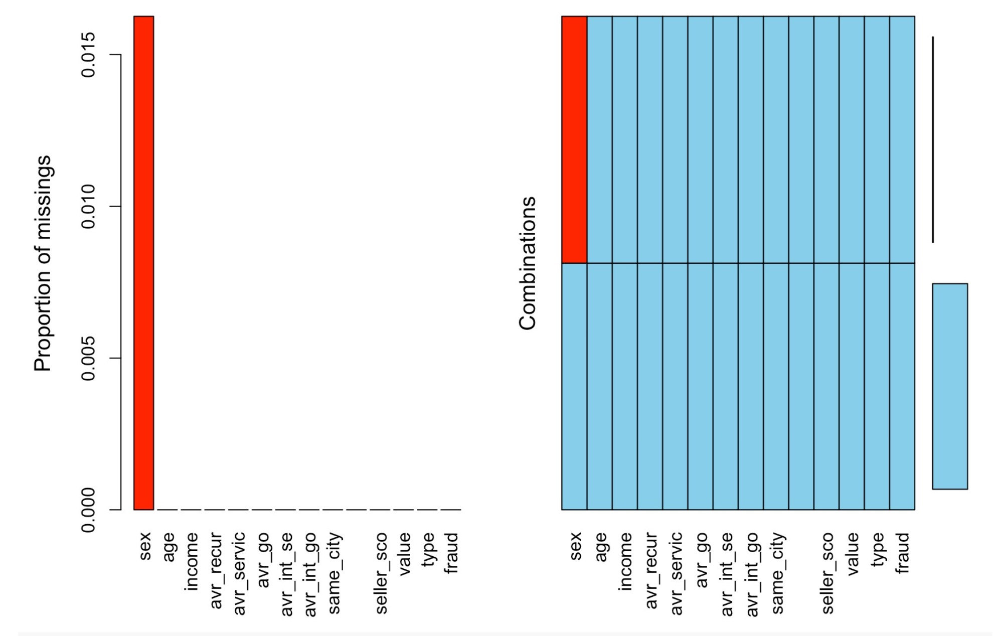
Data Exploration
The data contains 14 variables with 290398 observations.
We discovered that there are 4722 missing values in sex column.

Slide 8
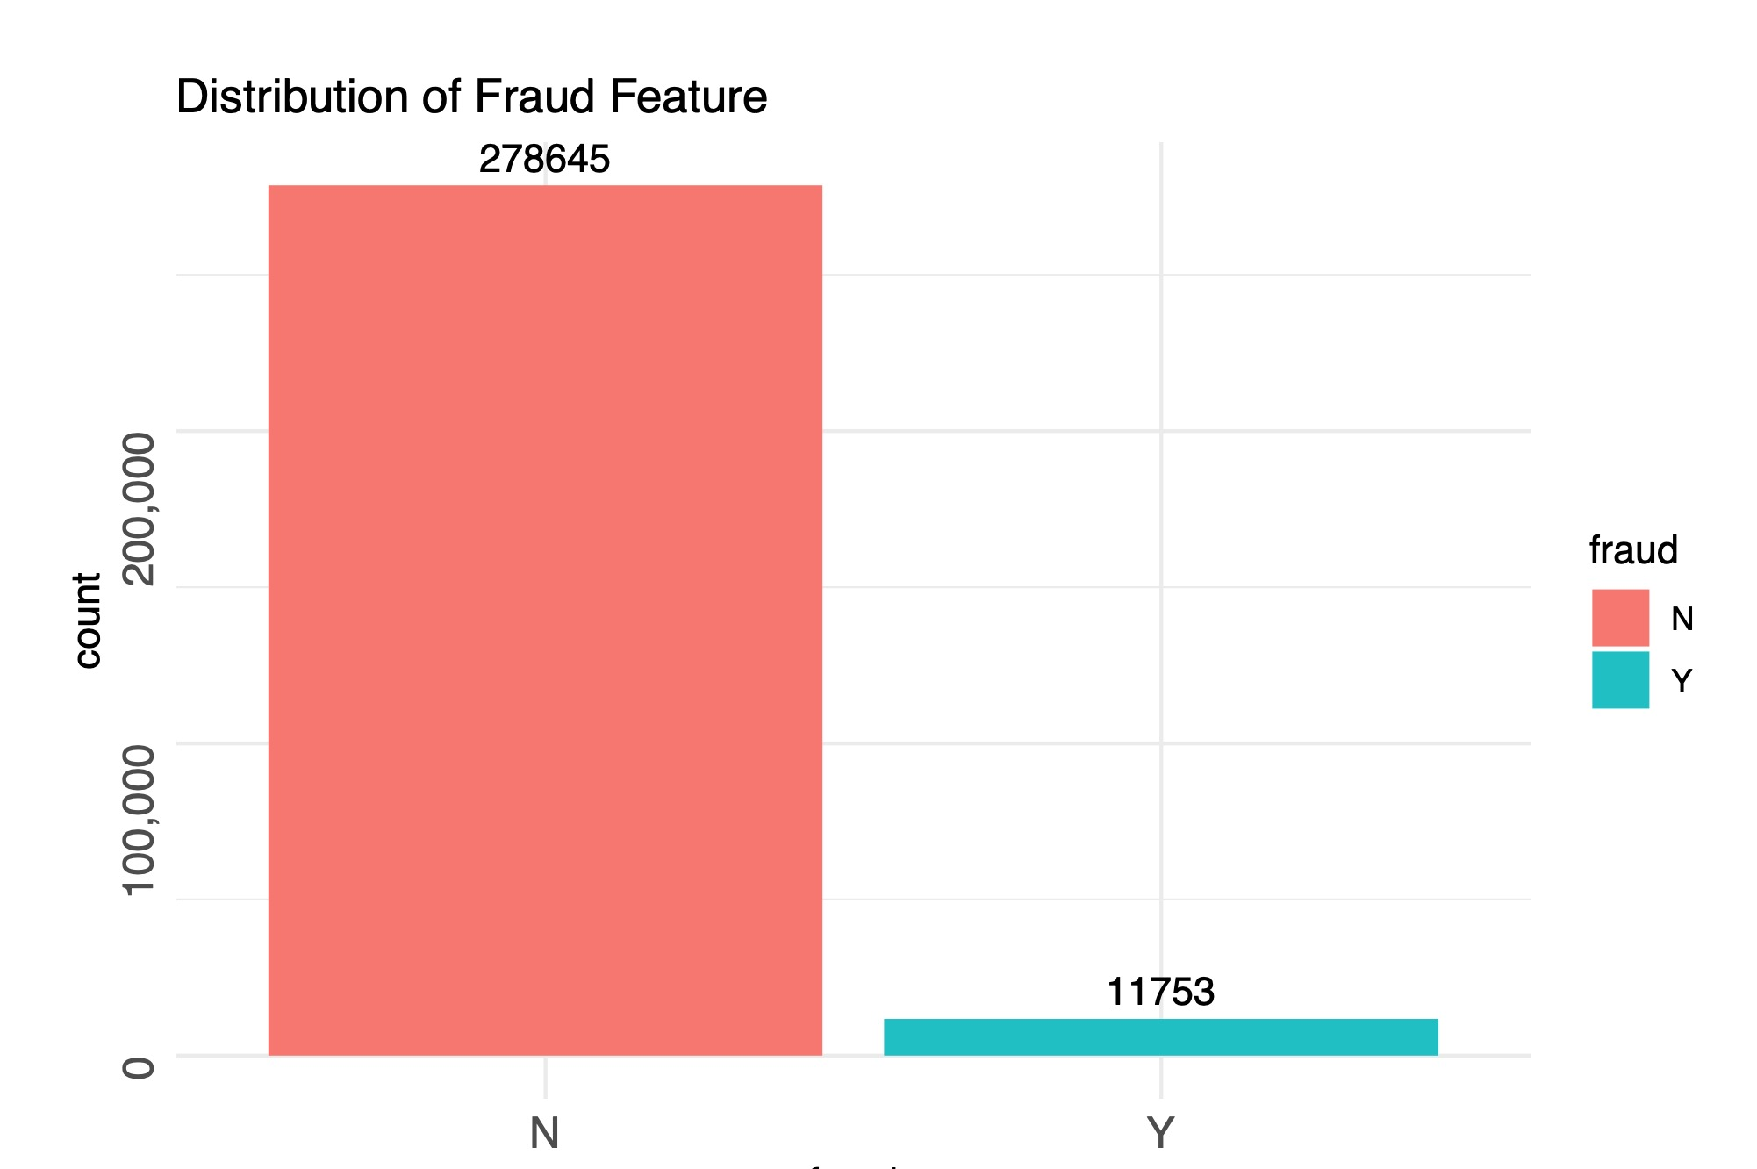
Data Exploration
Most transactions were non-fraudulent and our data is quite imbalanced. In fact, 95.95% of the transactions in this data set were not fraudulent while only 4.05% were fraudulent.

Slide 9
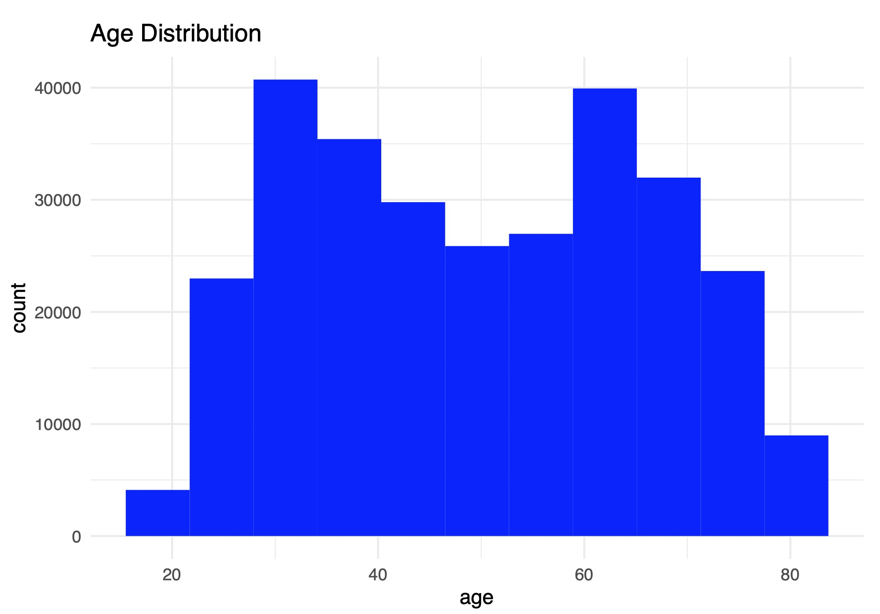
Data Exploration
Age distribution looks binomial, with two spikes in 30 and 65 year age groups.

Slide 10
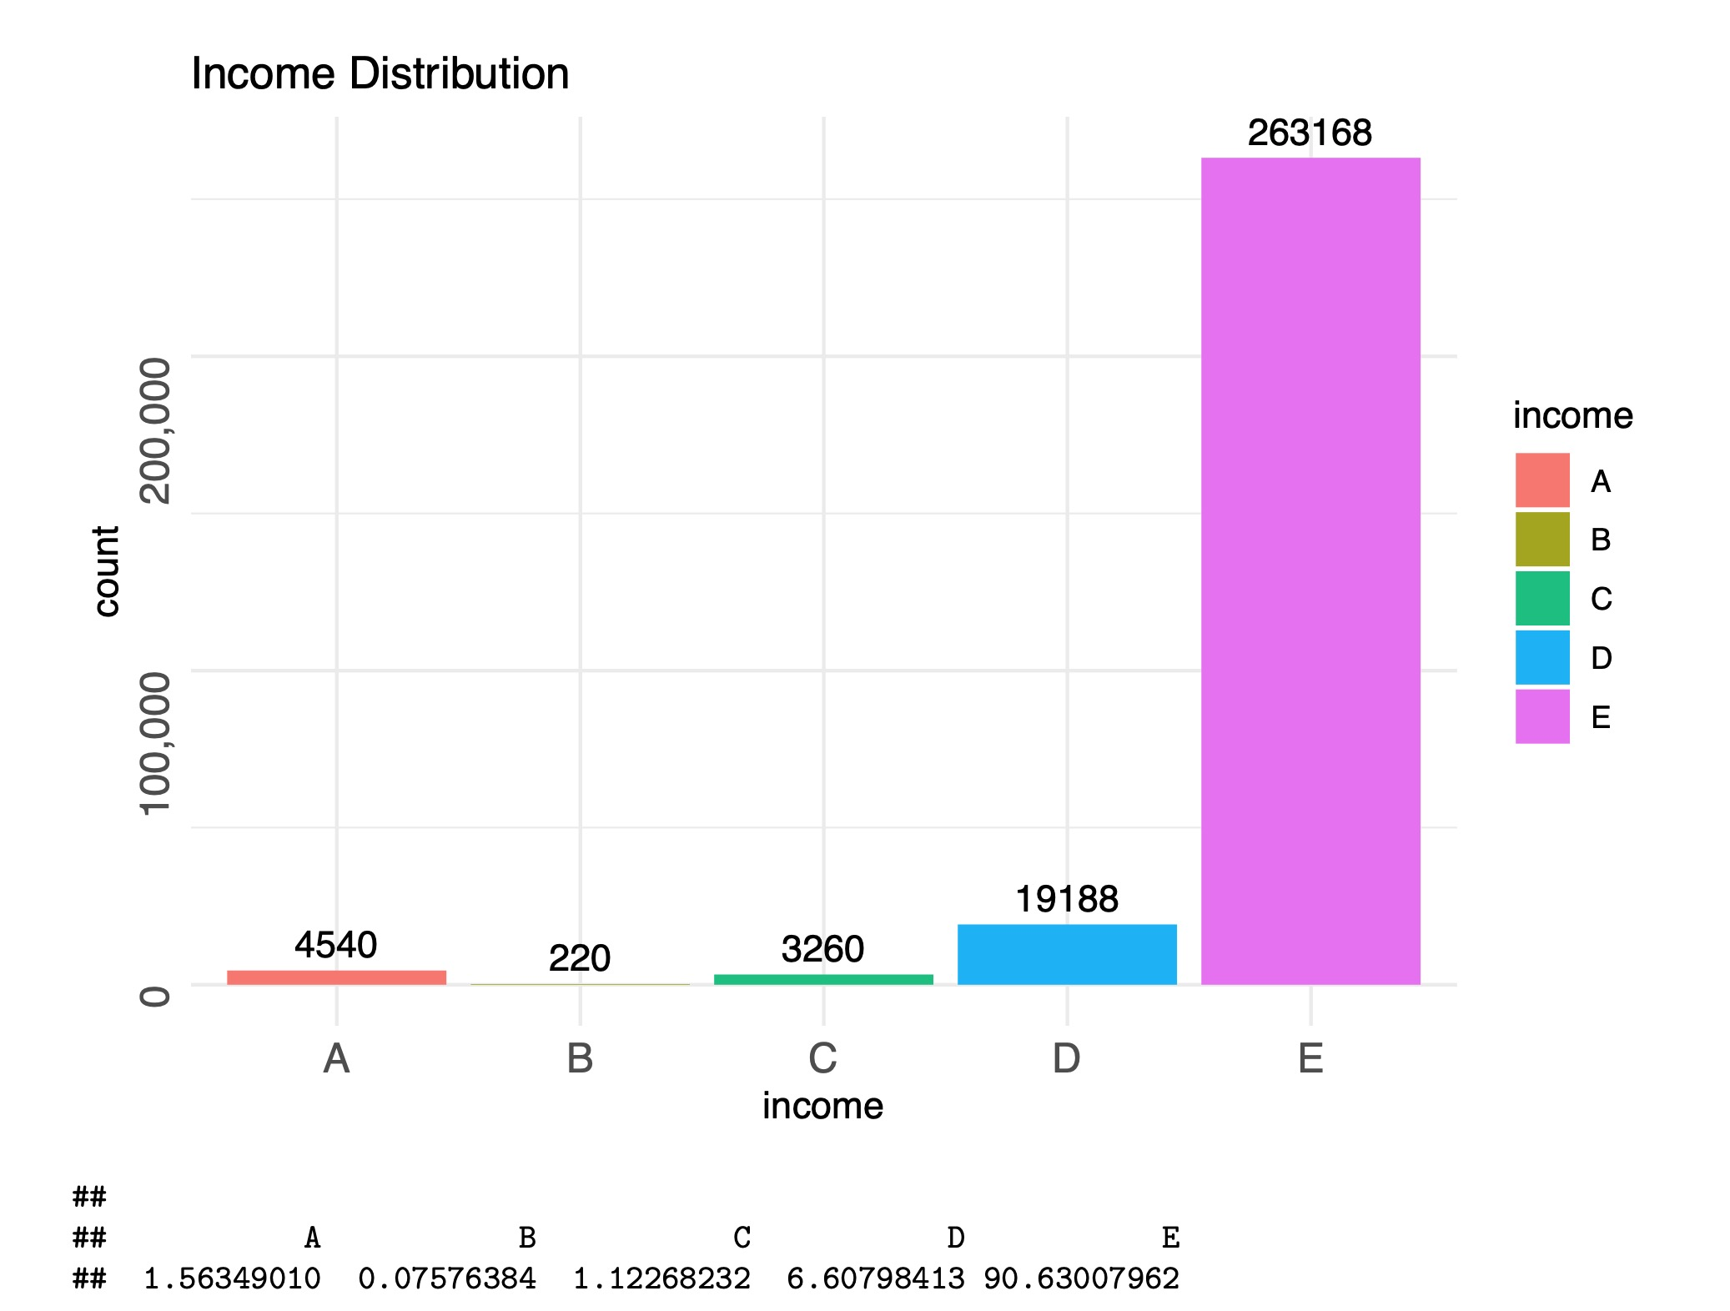
Data Exploration
The dataset is dominated by one income group category (E - 90.64%).

Slide 11
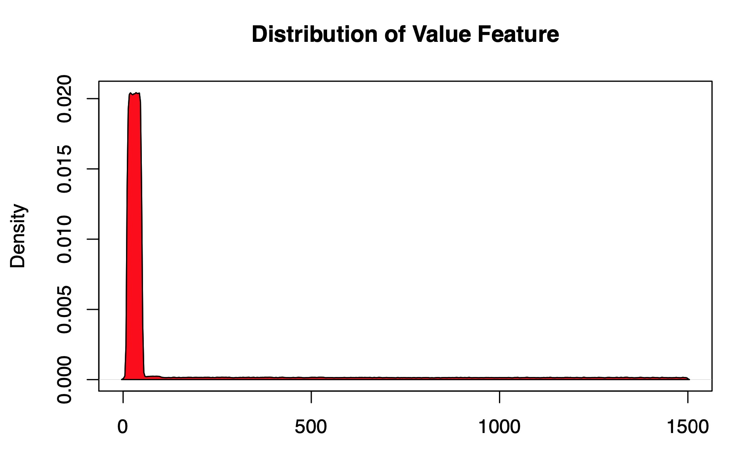
Data Exploration
The mean value of all transactions is $181 and mode is $35 while the largest
transaction recorded in this data set amounts to $1500. There are a few
transactions with close to zero amounts.

Slide 12
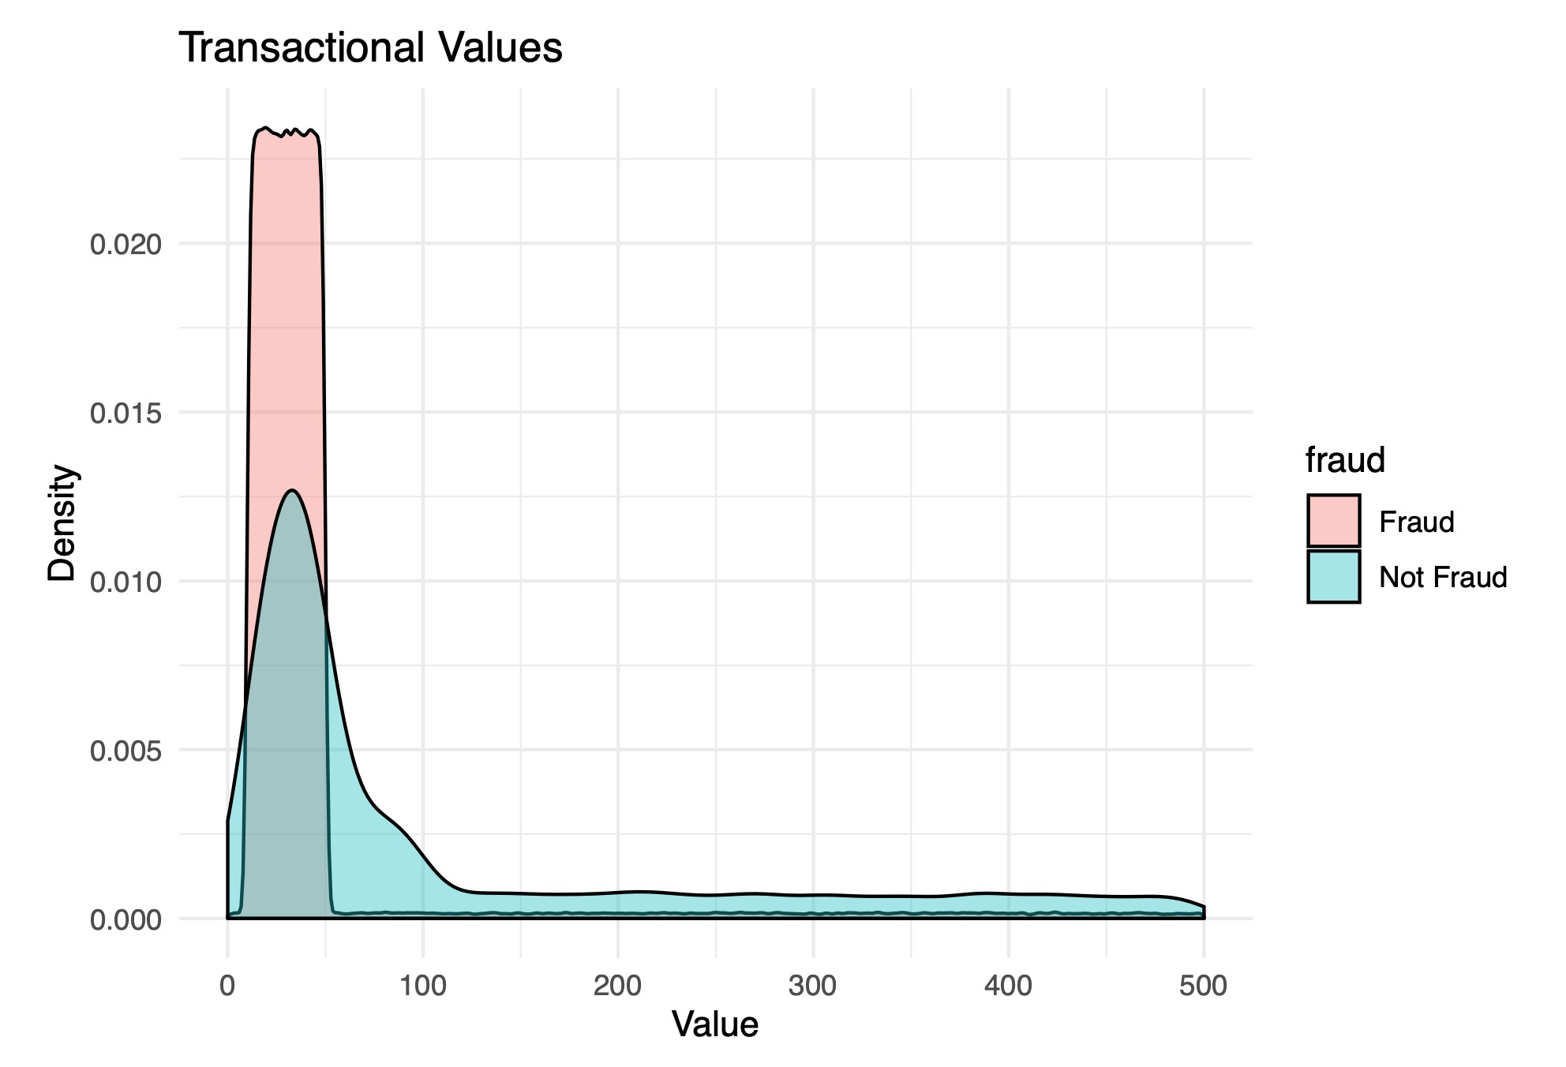
Data Exploration
It’s clear from this graph that most of fraud transactions occurred in lower rage,
between $5 and $55 of the transaction value.
However, we also see that other values of fraud transactions are evenly distributed.

Slide 13
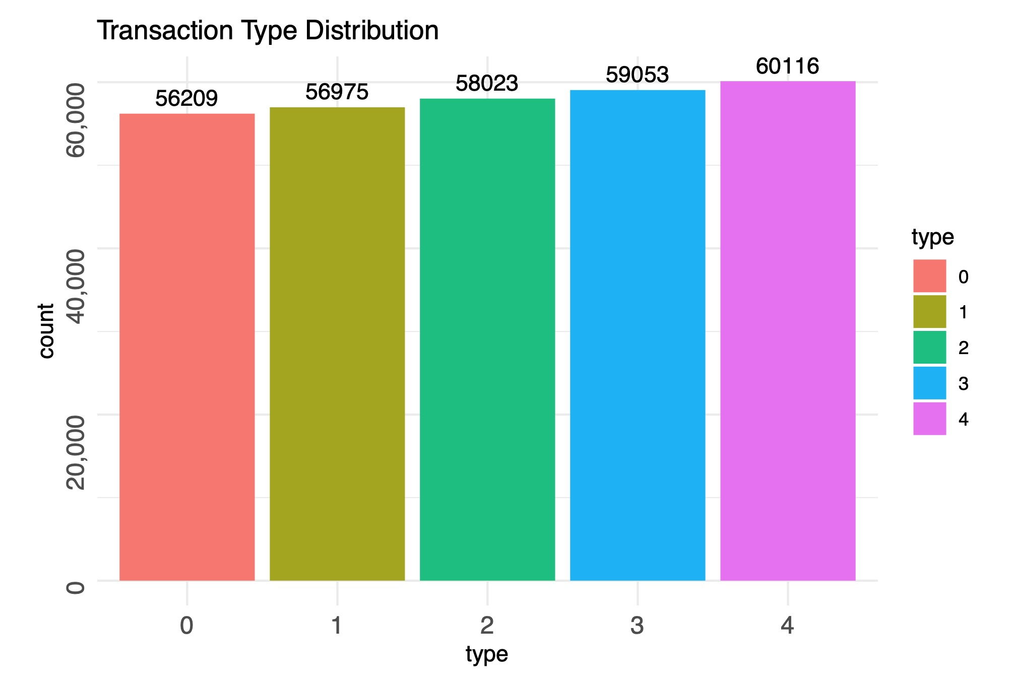
Data Exploration
The type feature has almost uniform distribution.
(0-recurrent, 1- goods, 2-services, 3-online goods or 4-online services)

Slide 14
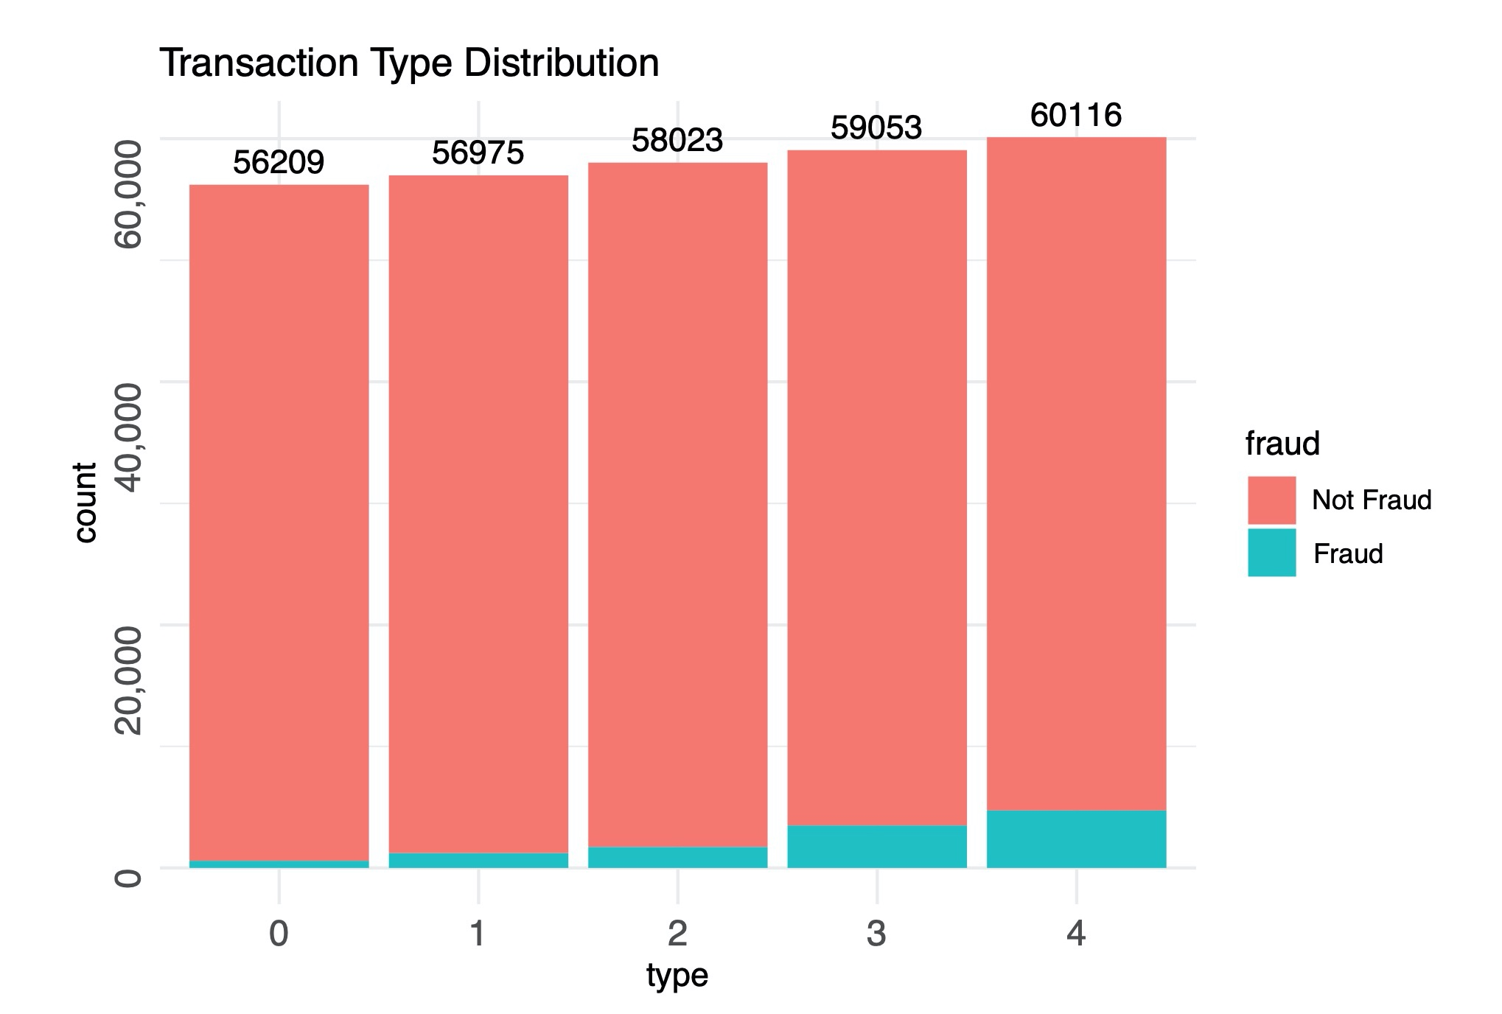
Data Exploration
It seems the online services category (4) has the highest percentage of fraudulent transactions.

Slide 15
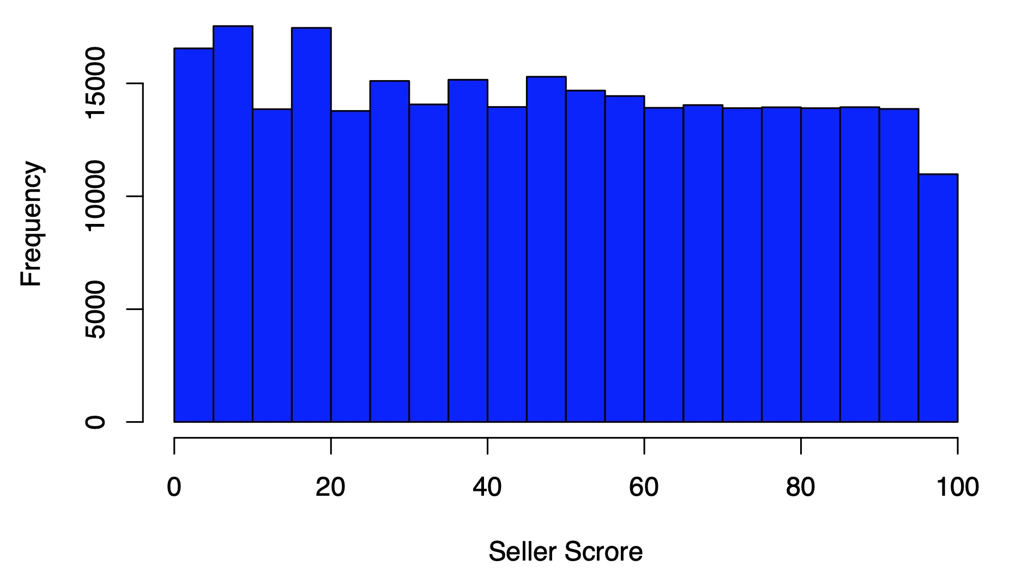
Data Exploration
The seller score feature has a uniform distribution as well.

Slide 16
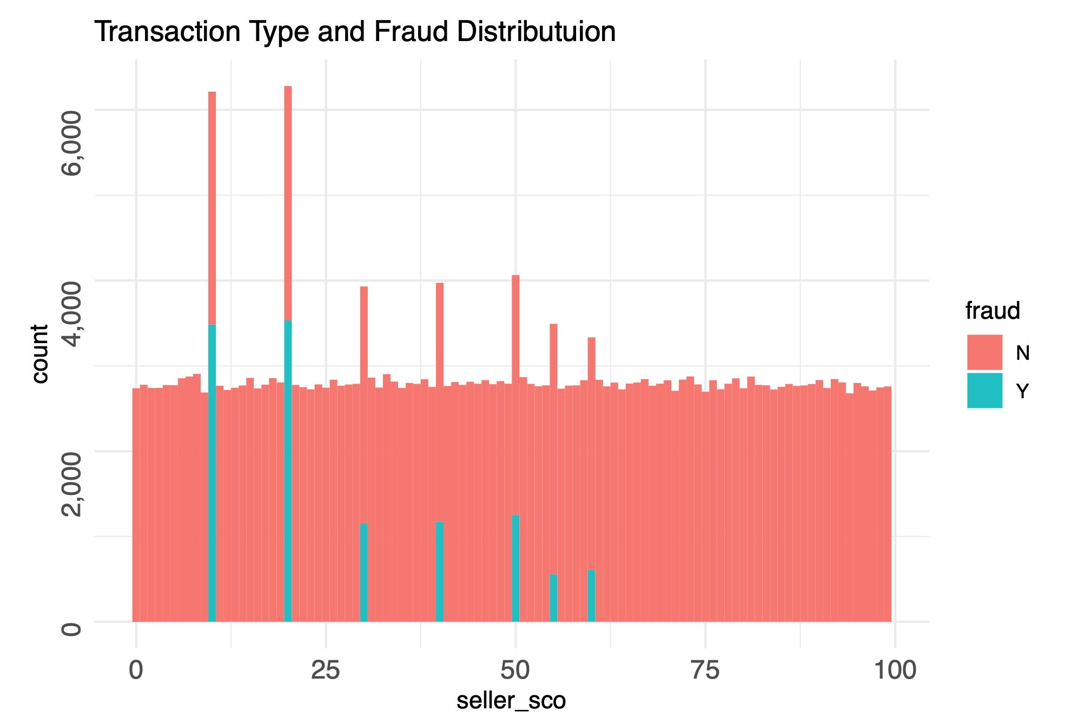
Data Exploration
Very interesting, only seven seller scores have fraudulent transactions and only two of the seven have a very high count of fraud transactions.

Slide 17
Data Treatment 1
We created three synthetic variables:
Dispersion: We calculated how far from the average the value of the transaction was in %
Cluster % of frauds: We clustered the transactions by profile (six variables) using K-means and check the % of frauds in the cluster.
Linear regression: We identified the correlation between eight variables and the frequency of frauds in %.

Slide 18
Data Treatment 2
We cross-validation the data in order to get good test and training subsets.
We decoded the data (using one hot encoding) in order to be able to use some techniques like extended gradient boost.
We balanced the training database due the fact that the frauds were just 4% of the samples.

Slide 19
Analytical Problem 1
We simulated a decision-tree without the synthetic variables.
We explored five models using balanced and unbalanced training data creating ten scenarios:
Decision-tree
Random-Forest
Random Forest + Bagging
Support Vector Machine Classifier
XGBoost

Slide 20
Analytical Problem 2

Slide 21
Conclusions 1

Slide 22
Conclusions 2
The findings showed a theoretical potential improvement of 44,89 % over the current model.
Theoretically every day the new model would be able to spot something around 5.936 additional frauds, totalizing a value around CAD 8.444.000 a month in terms of avoided frauds.
There is also the issue of the false positive that can lead to alienating clients, which due to our lack of understanding of the business is hard for us to define what would be acceptable.

Slide 23
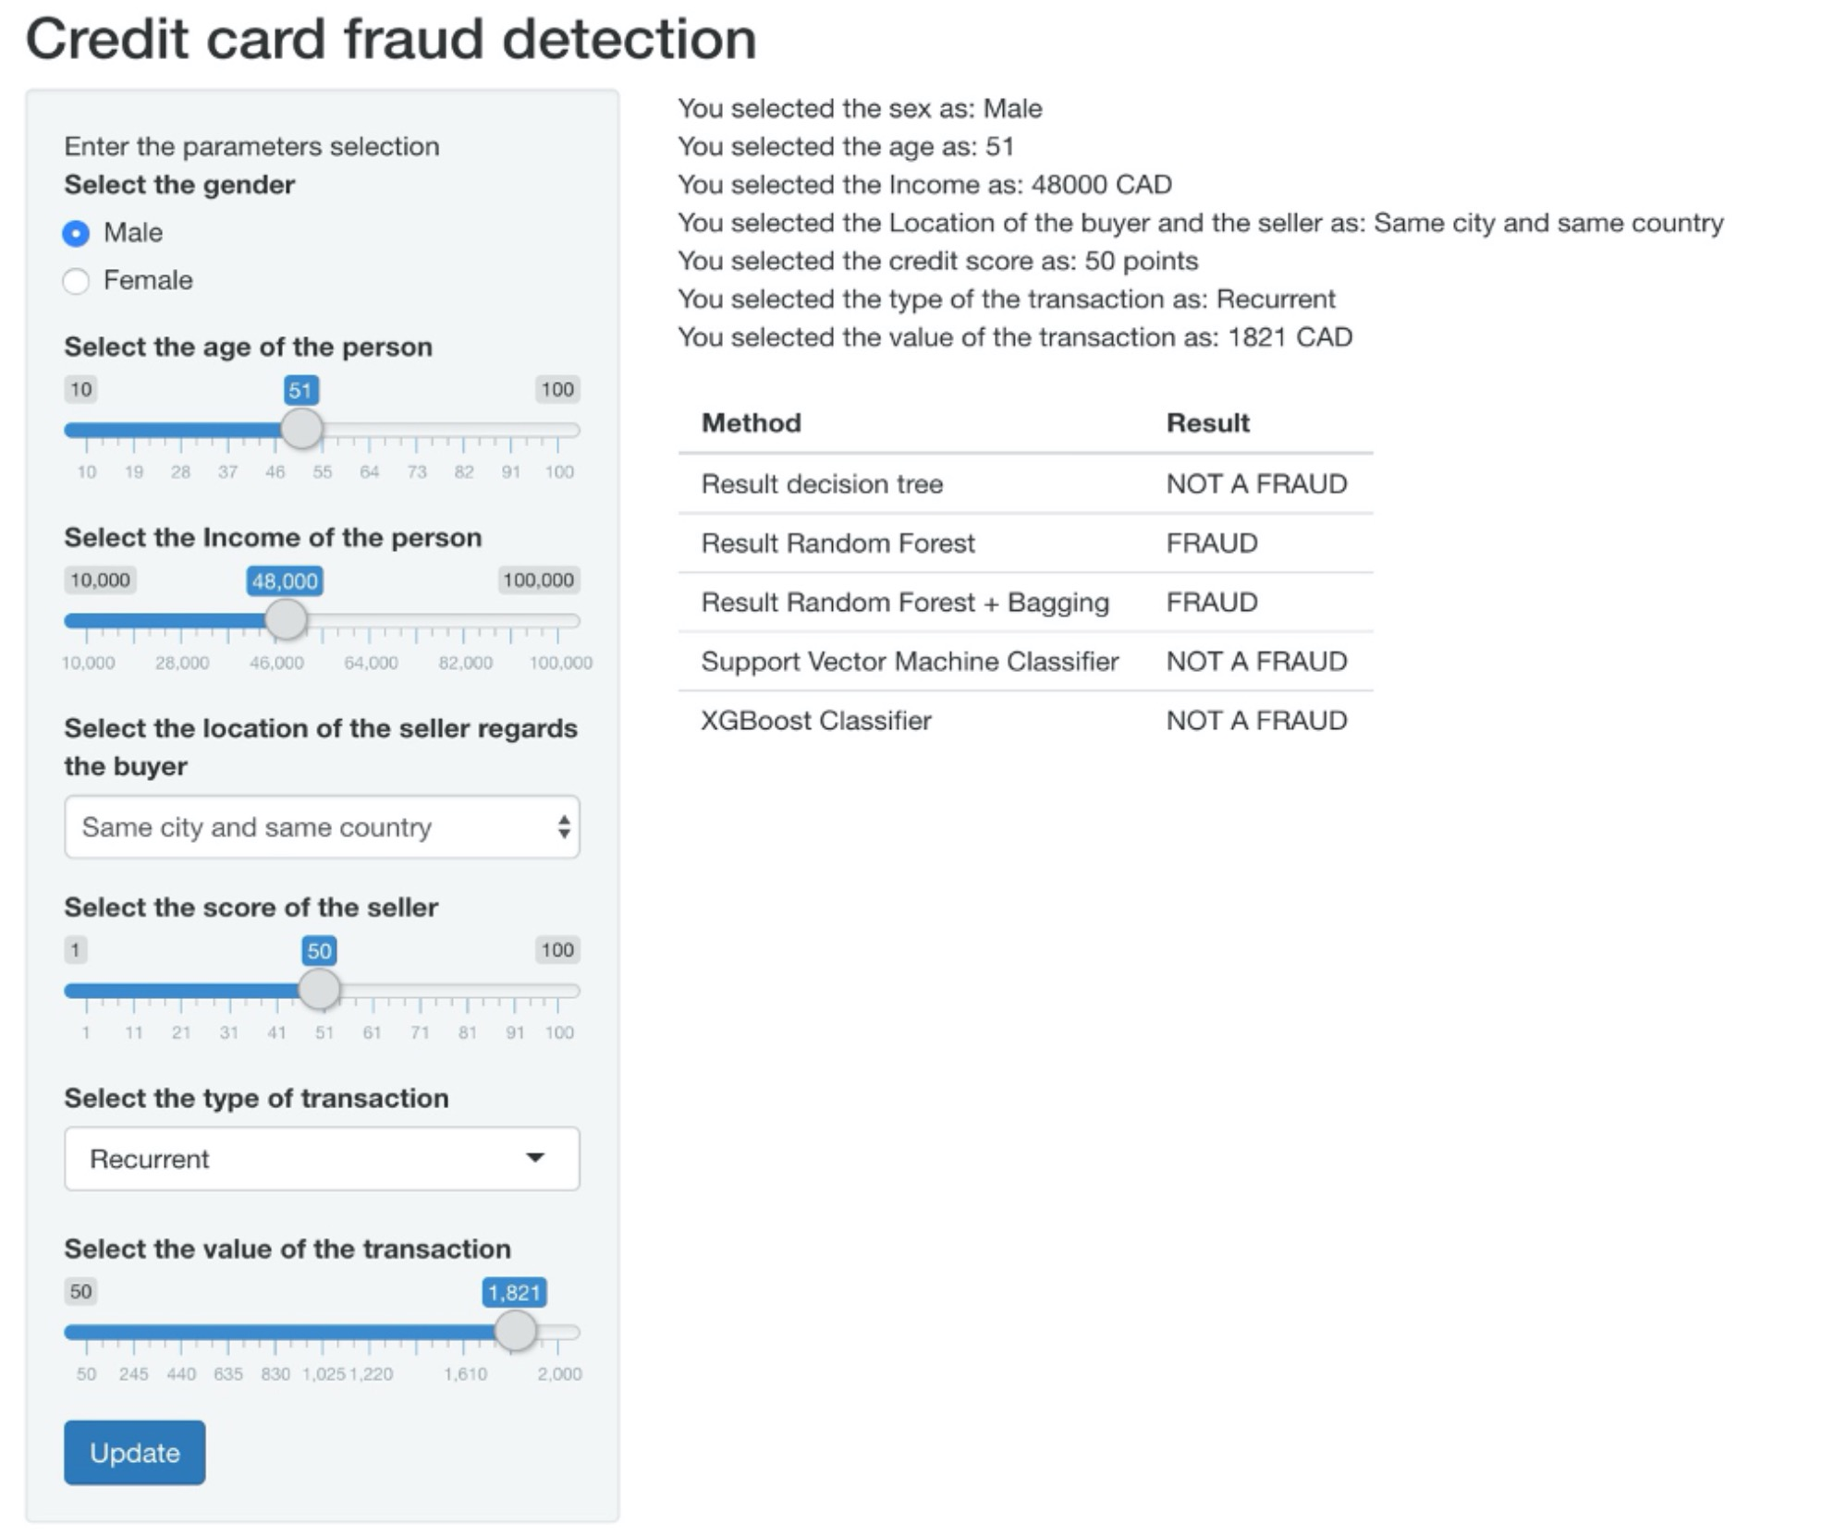
Shiny App
The end-user can select the following variables: age, sex, income, the score of the seller, transaction type and value of the transaction to predict fraudulent transactions
The output of the app shows a table with the prediction for each model.
We believe that the current app can be further improved for example it can use a majority voting and shows only one output based on all models.

